Slide 1
CSE422: Artificial intelligence
Genetic Algorithm
Asif Shahriar
Lecturer, CSE, BRACU

Slide 2
Genetic Algorithm – Borrowed from Nature
In nature, evolution helps populations of organisms adapt to their environment over time
GA mimics this process to evolve better solutions to problems
Each organism has a genome (a string of DNA) that encodes its characteristics
Organisms that are better suited to the environment are more likely to survive and reproduce (survival of the fittest)
In problem solving, fitness = how good is a candidate solution
Two organisms mix their genes to create offspring
Genes can mutate randomly—this introduces new traits that might be beneficial
Can be a way to escape the local maxima/minima
Over generations, the population becomes better adapted

Slide 3
0/1 Knapsack
Based on the information below try to maximize the value of the 0/1 knapsack problem when the size of your knapsack is 12Kg
Item | Weight | Value
A | 5 Kg | $12
B | 3 Kg | $5
C | 7 Kg | $10
D | 2 Kg | $7

Slide 4
0/1 Knapsack
Step 1: Generate Initial Population (Encoding).
Randomly generate 4-bit strings (chromosome), where each bit represents whether the item is chosen (1) or not (0)
0 1 1 0 -> B and C chosen
1 0 0 0 -> A chosen
1 1 1 1 -> A, B, C, D chosen
0 0 1 1 -> C and D chosen
Step 2: Calculate fitness score.
0 1 1 0 -> 10 Kg - $15
1 0 0 0 -> 5 Kg - $12
1 1 1 1 -> 17 Kg - $34
0 0 1 1 -> 9 Kg - $17

Slide 5
0/1 Knapsack
Step 3: Select Parents (Natural selection).
p_{i} = f_{i} / ∑_{i} f_{i} for i =1,2,...n
String No | Chromosome | Weight | Fitness Score (f_{i}) | p_{i}
1 | 0 1 1 0 | 10 | 15 | 0.34
2 | 1 0 0 0 | 5 | 12 | 0.27
3 | 1 1 1 1 | 17 | 0 | 0.0
4 | 0 0 1 1 | 9 | 17 | 0.39
SUM |  |  | 44 | 1

Slide 6
0/1 Knapsack
Step 4: Crossover.
Let we chose parents (1, 4) and (2, 4)
String No | Mating Pool | Crossover point | Offspring | Weights | Fitness Score (f_{i})
1 | 0 | 1 1 0 | 0 | 0 0 1 1 | 9 | 17
4 | 0 | 0 1 1 | 0 | 0 1 1 0 | 10 | 15
2 | 1 0 0 | 0 | 2 | 1 0 0 1 | 7 | 19
4 | 0 0 1 | 1 | 2 | 0 0 1 0 | 7 | 10
SUM |  |  |  |  | 61

Slide 7
0/1 Knapsack
Step 5: Mutation.
String No | Offspring | Mutation Point | Offspring (After mutation) | Weights | Fitness Score (f_{i})
1 | 0 0 1 1 | 3 | 0 0 1 0 | 7 | 10
4 | 0 1 1 0 | 0 | 1 1 1 0 | 17 | 0
2 | 1 0 0 1 | 1 | 1 1 0 1 | 10 | 24
4 | 0 0 1 0 | 0 | 1 0 1 0 | 12 | 22
SUM |  |  |  |  | 56

Slide 8
Genetic Algorithm: FLOWCHART
Start
Create initial Population of Choromosomes
Calculate fitness value
Select parents
Yes
Optimal Solution?
No
Reproduce
(Crossover)
End
Mutate **
New generation

Slide 9
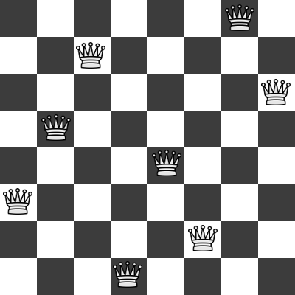
N Queens Problem
The goal is to place N queens on an NxN chessboard so that no two queens threaten or attack each other. To prevent the queens from attacking one another, no two queens should be in the same row, column, or diagonal.

Slide 10
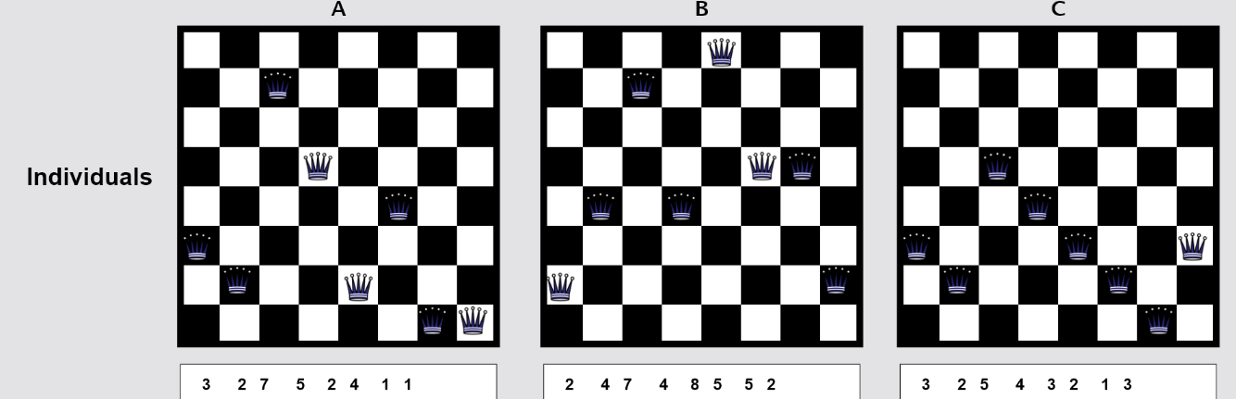
8 Queens Problem
Step 1: Initial population (Encoding).
Chromosomes of 8 bits – i-th bit represents position of a queen in i-th column

Slide 11
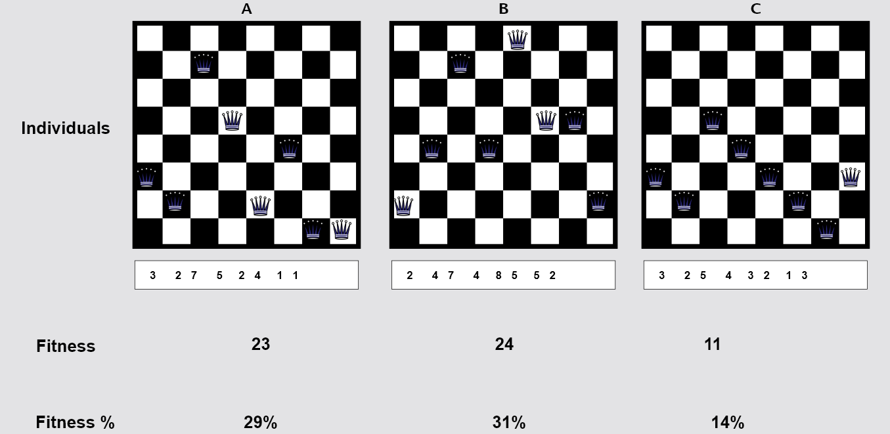
8 Queens Problem
Step 2: Calculate fitness score.
Fitness function: number of non-attacking pairs of queens

Slide 12
8 Queens Problem
Step 3: Select parents.
3 | 2 | 7 | 5 | 2 | 4 | 1 | 1
2 | 4 | 7 | 4 | 8 | 5 | 5 | 2
Step 4: Crossover.
3 | 2 | 7 | 5 | 2 | 4 | 1 | 2
23
2 | 4 | 7 | 4 | 8 | 5 | 5 | 1
26

Slide 13
8 Queens Problem
Step 5: Mutation.
3 | 2 | 7 | 5 | 2 | 4 | 1 | 2
23
3 | 2 | 7 | 5 | 8 | 4 | 1 | 2
25
2 | 4 | 7 | 4 | 8 | 5 | 5 | 1
26
2 | 4 | 7 | 4 | 8 | 5 | 3 | 1
27

Slide 14
8 Queens Problem
Step 6: New generation.
Suppose we have: parents [p1, p2, p3, p4] and children [c1, c2, c3, c4]
New generation size must be equal to previous generation
Option 1: new generation = children
Option 2: elitism
k-elitism: choose k best chromosomes from [parents, children], remaining chromosomes will be from children
Suppose in terms of fitness, c1 > p4 > p3 > c2 > c4 > p1 > p2 > c3
Using 2-elitism, new generation = [c1, p4, c2, c4]

Slide 15
Pseudocode
function GENETIC_ALGORITHM( population, FITNESS-FN) return an individual
input: population, a set of individuals
FITNESS-FN, a function which determines the quality of the individual
repeat
new_population ← empty set
for i from 1 to SIZE(population) do
x ← RANDOM_SELECTION(population, FITNESS_FN)
y ← RANDOM_SELECTION(population, FITNESS_FN)
child ← REPRODUCE(x,y)
if (small random probability) then child ← MUTATE(child )
add child to new_population
population ← new_population
until some individual is fit enough or enough time has elapsed
return the best individual

Slide 16
Practice problem 1
You are to produce the following string “I_LOVE_AI” using the following characters “ABC...Z_” (27 in total). Use GA to produce this string.
What will be the chromosome?
What should be the fitness function?
Work out all steps for 5 iterations.

Slide 17
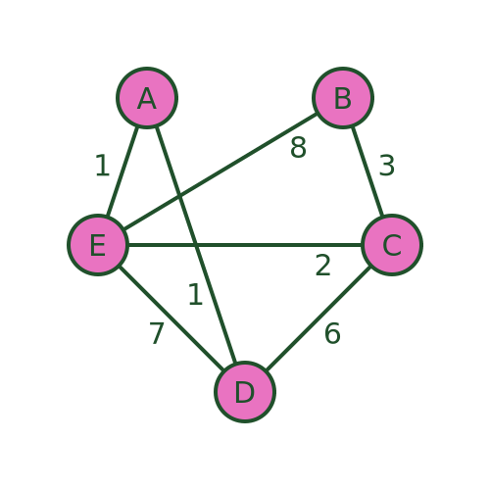
Practice problem 2: TSP
5 cities are connected using bi-directional roads as shown in the graph. A salesman will start from a particular city, visit all cities exactly ONCE, and return to the starting city, while covering the shortest path.
Find out the tour as well as the cost using GA.
What will be the chromosome?
What should be the fitness function?
Work out all steps for 5 iterations and report the best tour found.

Slide 18
Merits and Demerits of GA
Merits:
GAs are less likely to get stuck in local optima because of crossover and mutation
Diverse population encourages exploration across search space
Flexible and versatile – can be applied to a wide range of problems
Often finds a “good enough” solution quickly
Demerits:
Not optimal: often finds “good enough” solutions but not necessarily best solution
Slow: may take many generations to converge
Needs careful selection of parameters (mutation rate, num of generations, etc)
Poor fitness function makes GA ineffective

